Slide 1
Theory of Consumer Demand
Steven Suranovic
George Washington University

Slide 2
Individual Demand
Assume a person has an income (I) measured in dollars
Assume two goods oranges and apples
Let QO be the quantity of oranges demanded
Let QA be the quantity of apples demanded
Each good has a market price PO ($/Or), PA ($/Ap)
Assume the person has standard preferences
More is better
Diminishing marginal utility

Slide 3
The Individual Budget Constraint
The budget constraint is an equation showing how a given income can be used to purchase various quantities of apples and oranges.
POQO + PAQA ≤ I
Note POQO = Amount of dollars spent on QO oranges
Note PAQA = Amount of dollars spent on QA apples

Slide 4
The Individual Budget Constraint
If all income is spent then the budget constraint becomes …
POQO + PAQA = I (an equality)
Now if QA = 0 … then QO = I/PO (endpoint on orange axis)
If QO = 0 … then QA = I/PA (endpoint on apple axis)
Plug in values for I, PO and PA to check

Slide 5
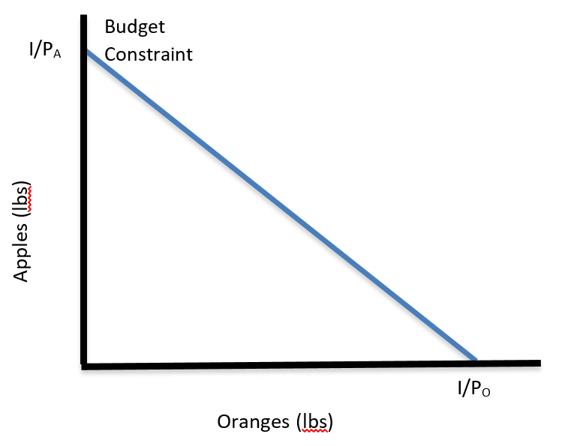
The Individual Budget Constraint
Note the slope of this constraint
Slope = rise/run
Slope = - (I/PA)/(I/PO)
= - (I/PA)/(PO/I)
= - (PO/PA)
= the terms of trade

Slide 6
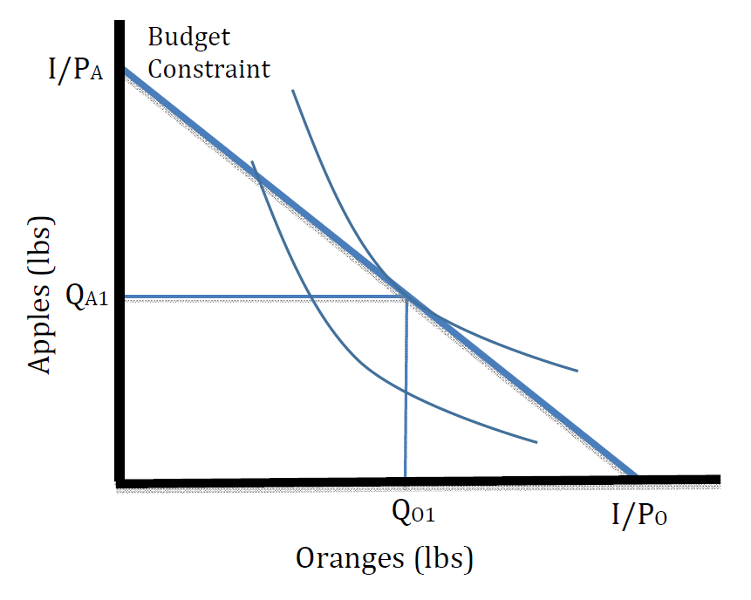
The Individual Utility Maximum
Condition
(PO/PA) = MRS (slope of IC )
Utility maximum achieved at QO1 and QA1
The outcome is called an equilibrium … meaning the behavioral forces (utility max) will result in this outcome

Slide 7
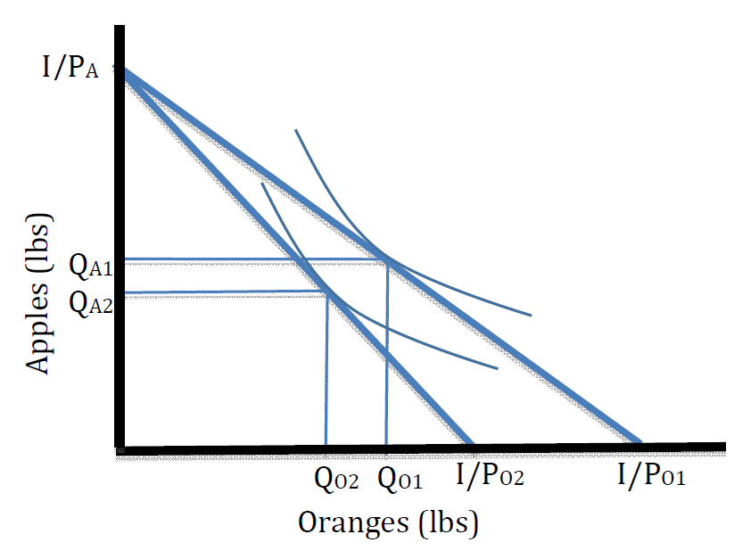
Effects of an Increase in PO (→ QO falls)
Suppose the price of oranges rises from PO1 to PO2
Budget constraint orange-intercept shifts left
Utility maximum achieved at QO2 and QA2
QO2 falls (negative relationship with orange price)

Slide 8
The Ceteris Paribus Assumption
Suppose the price of oranges rises from PO1 to PO2, ceteris paribus
Ceteris paribus means that no other variable, such as PA or I are also changing
In other words, PA and I are kept fixed when PO changes

Slide 9
A Comparative Statics “Experiment”
An “experiment” in which the researcher changes one variable in a model, such as the price of oranges
Ceteris paribus, i.e. keeping all other variable values fixed at their original levels
And determines the effect on the equilibrium

Slide 10
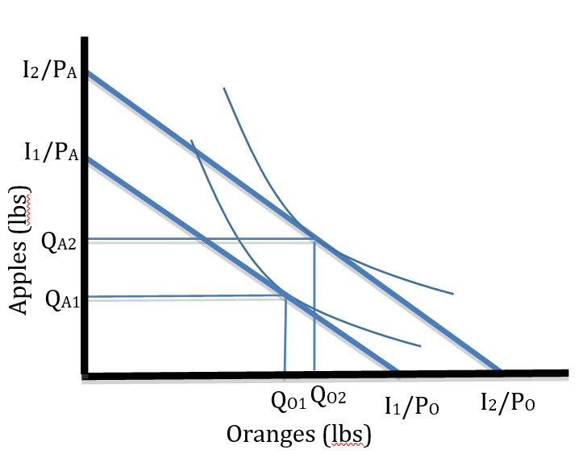
Effects of an Increase in Income (→ QO rises)
Suppose the individual’s income rises from I1 to I2, ceteris paribus
Budget constraint orange and apple-intercepts shift up
Utility maximum achieved at QO2 and QA2
QO2 rises (positive relationship with orange price)
A Normal good is one that has a positive relationship between income and demand

Slide 11
From Individual Demand to Market Demand
Assume the market has numerous utility-maximizing consumers
Price changes and income changes affect everyone similarly, though maybe not exactly.
Complicate the market model by introducing many more economic variables that may affect demand for a good

Slide 12
Demand Determinants for a Good (coffee)
P = Own price (price of coffee)
I = Income (avg. household in the market community)
PS = price of substitute goods (eg. tea, juice, etc)
PC = price of complementary goods (eg. sugar, cream, etc)
T = Tastes (strength of desire for coffee)
FP = expected future price of coffee (average across all consumers)
FI = expected future income (exp. Average community income)
NB = total number of coffee consumers in the market

Slide 13
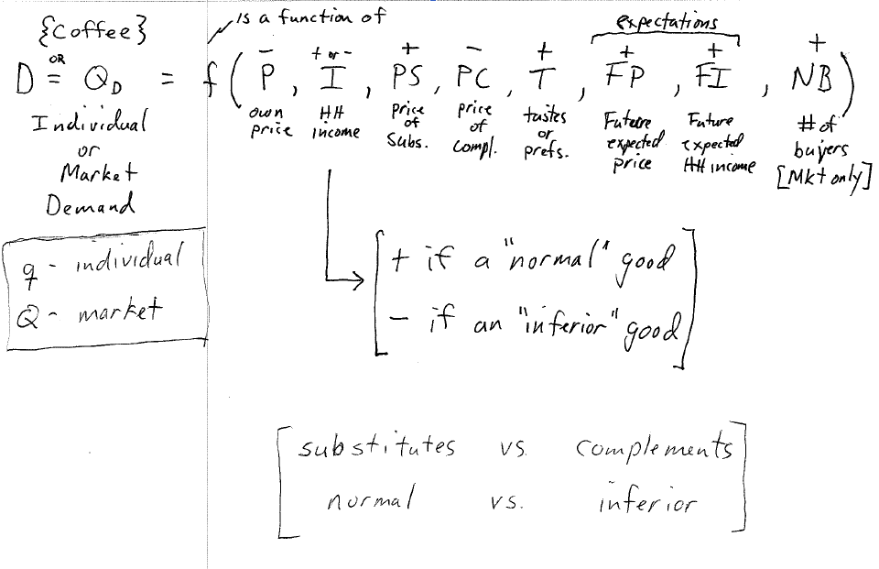

Slide 16
A Linear Demand Function Example
Suppose
D = -P + (1/10)I + (1/2)PS – (1/4)PC + 5
Ceteris Paribus (Everything else constant) - Let
I = 300 (community income)
PS = 20 (eg tea)
PC = 20 (eg. cream).
Let the “5” incorporate T, FP, FI and NB

Slide 17
A Linear Demand Function Example
Suppose
D = -P + (1/10)I + (1/2)PS – (1/4)PC + 5
Then D = -P + (1/10)*300 + (1/2)*20 – (1/4)*20 + 5
= -P + 30 + 10 – 5 + 5
= -P + 40
D = 40 – P

Slide 18
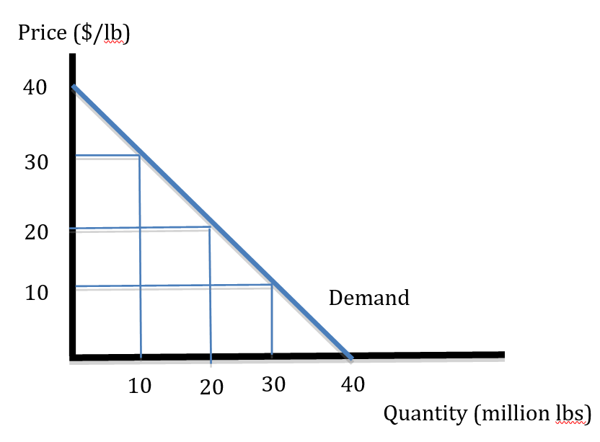
A Linear Demand Function Example
Price ($/lb) | Demand (million lbs per month)
$40 | 0
$30 | 10
$20 | 20
$10 | 30
$0 | 40

Slide 19
Shifts in the Demand Function
Suppose
Income falls from 300 to 200 units
D = -P + (1/10)*200 + (1/2)*20 – (1/4)*20 + 5
D = 30 - P

Slide 20
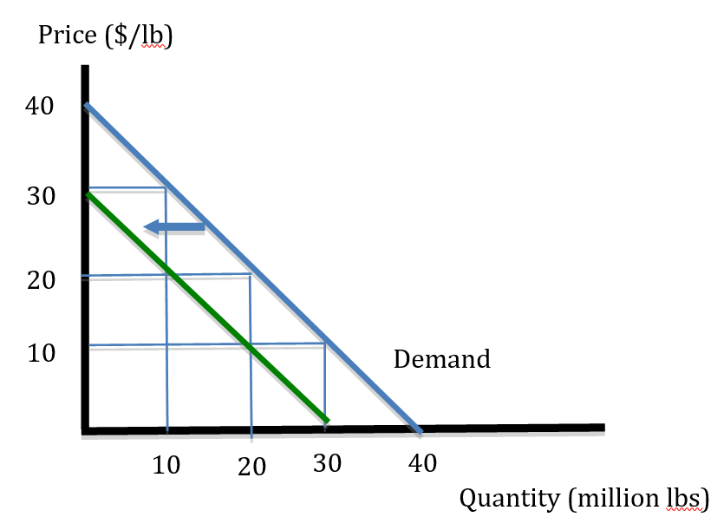
Shifts in the Demand Function
Price ($/lb) | Demand (I=300) (million lbs per month) | Demand (I=200) (million lbs per month)
$40 | 0 | -
$30 | 10 | 0
$20 | 20 | 10
$10 | 30 | 20
$0 | 40 | 30

Slide 21
Shifts in the Demand Function
Rules of Thumb
Changes in the own price does not shift the demand function because price is plotted on the graph. Changes in price causes a movement along the demand curve.
Changes in any other variable affecting demand, not plotted on the diagram, causes a shift (right or left) of the demand curve
Includes I, PS, PC, T, FP, FI, NB

Slide 22
Shifts in the Demand Function
Demand Right Shifters
Demand Left Shifters
↑ I (if normal)
↓ I (if inferior)
↑ PS, T, FP, FI, NB
↓ PC
↓ I (if normal)
↑ I (if inferior)
↓ PS, T, FP, FI, NB
↑ PC

